Slide 1
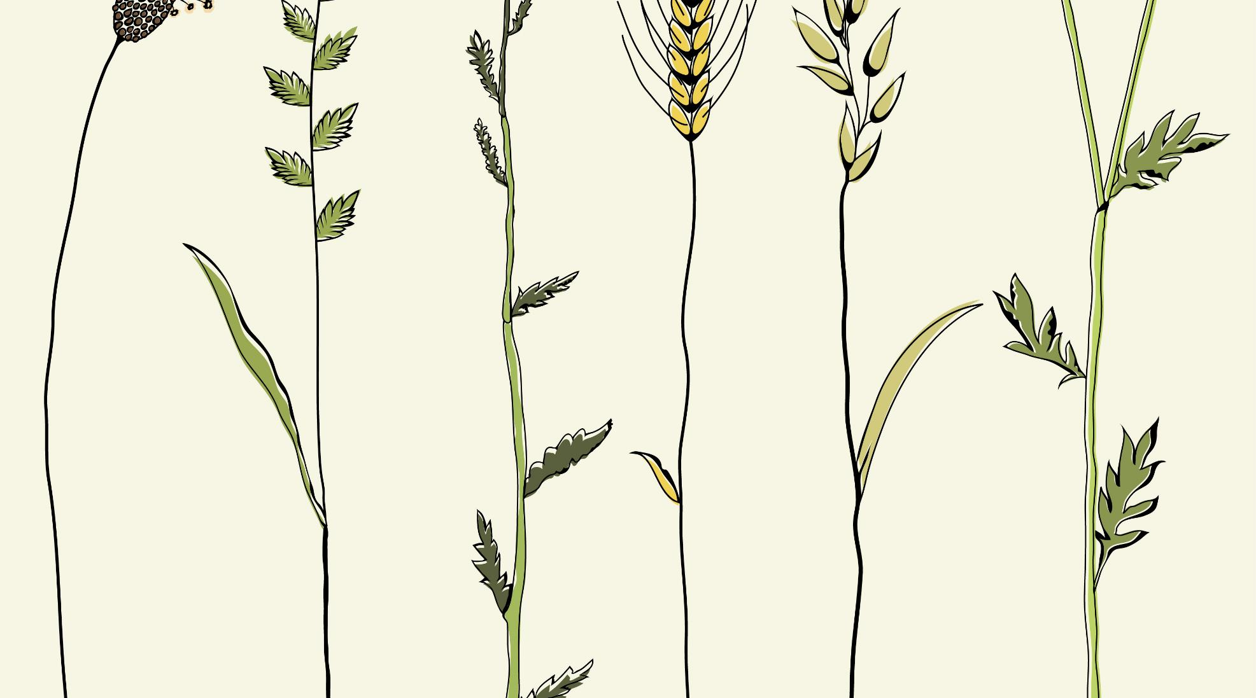
Precision Agriculture – Coimbatore based crop suggestion system using ML and IoT
TEAM 9
Gayathri B – 18Z218
Poovizhi Mangai S K – 18Z236
Praja S S – 18Z237
Shivathmica C – 18Z249
Sneha Sridharan – 18Z252
Guide Name: Dr. N. Gopika Rani
Company Name: Niagara Automations, Coimbatore

Slide 2
PROBLEM STATEMENT
Farmers are not aware of the right crop according to their soil characteristics and site specific parameters. Due to this the yield can be low and they face a setback in productivity.
A system to recommend the most appropriate crop to farmers using machine learning techniques based on certain input parameters like soil pH, EC (Electrical Conductivity), N, P, K, soil type, soil moisture, area and environmental conditions like temperature and humidity will help significantly increase productivity and reduce loss.
The trained model is further given real time inputs from the IoT system along with user inputs to give the output.

Slide 3
LITERATURE SURVEY
Paper name | Methodology used | Advantages | Disadvantages
AgroConsultant: Intelligent Crop Recommendation System Using Machine Learning Algorithms Zeel Doshi, Rashi Agrawal, Subhash Nadkarni, Prof. Neepa Shah | Decision Tree (90.2%) K Nearest Neighbor (K-NN) (88.78%) Random Forest (90.43%) Neural Network (91%) | Compared various algorithms and chose the best one. Accuracy of the model is very high. | Absence of sensors for input making it essential for users to type all the inputs. Multiple models are not used together.
Crop Recommendation System for Precision Agriculture S.Pudumalar, E.Ramanujam, R.Harine Rajashree, C.Kavya, T.Kiruthika, J.Nisha | Ensemble Model (Voting Based classifier) Random tree, CHAID, K-Nearest Neighbor and Naive Bayes (88%) | Combined the power of multiple models. Use of varying soil parameters. | Environmental parameters are not used in this model.

Slide 4
Paper name | Methodology used | Advantages | Disadvantages
Implementation of Machine Learning Algorithms for Crop Recommendation Using Precision Agricuture K. R. Akshatha, K. S. Shreedhara | Ensemble model with majority voting technique, using a combination of models like Random tree model, K-Nearest Neighbor model and Naïve Bayes model. | -Sufficient soil specific attributes are considered. - Ensemble model gives more prediction and efficiency than any of its models could achieve alone. | - The combination of these models may not be complementing each other so hence might not produce high accuracy in recommendation.
Machine learning approach: Recommendation of suitable crop for land using meteorological factors Srilakshmi A, Madhumitha K, Geetha K | Random forest, decision tree and SVM | -Ample number of datasets are collected for training and testing for better accuracy. - Aimed at deciding which model has highest accuracy: Random forest -95.09%. | -Less soil parameters are considered. -Only static data is provided to the trained model.

Slide 5
Paper name | Methodology used | Advantages | Disadvantages
Recommendation System for ​ Crop Identification and Pest Control Technique in ​ Agriculture​ Avinash Kumar, Sobhangi and Chittaranjan Pradhan​ ​ | SVM Classification (89.66%)​ Decision Tree (86.80%)​ Logistic Regression (86.04%)​ | All major parameters are included for recommendation system.​ Used different algorithms to choose the one with highest accuracy.​ Apart from identification, Pest control techniques is also suggested.​ ​ | Since the user manually input the values, he may be unaware of the exact values which might mislead.​
Recommendation System Using Neural Networks Tanmay Banavlikar, Aqsa Mahir, Mayuresh Budukh, Soham Dhodapkar | Artificial Neural Networks IoT | The input data are collected using sensors to get the accurate value which gives the correct recommendation. | Few more parameters could be taken into account for more effective recommendation.

Slide 6
Paper name | Methodology used | Advantages | Disadvantages
Crop Recommendation System through Soil Analysis Using Classification in Machine Learning Dr.A.K.Mariappan, Ms C. Madhumitha, Ms P. Nishitha, Ms S. Nivedhitha | Random Forest and KNN algorithm | Compared various algorithms and chose the best one | Absence of sensors for input making it essential for users to type all the inputs.

Slide 7
OUR PROPOSED SYSTEM
METHODOLOGY
Ensemble model with majority voting technique, using a combination of algorithm namely Random Forest, kNN, and Decision Tree.
Arduino Uno embedded with Temperature sensor, pH sensor, Soil Moisture sensor and Humidity sensor to input accurate values of the above parameters to the system.
ADVANTAGES
Designed exclusively for areas in and around Coimbatore.
All necessary soil parameters are taken into consideration.
Ensemble model gives more prediction and efficiency than any of the models could achieve alone.
Since IoT is implemented to collect input data, the recommendation system is very precise and suitable.

Slide 8
SYSTEM DESIGN
Sensor Data (IoT)
User Input (Location, Soil type)
Environment Data
Random Forest
Decision Tree
KNN
Trained Model
Recommended crop
Data Pre-processing like treating missing values and outliers
Feature Scaling
Ensemble Model
Soil Characteristics

Slide 9
Arduino Uno R3 and Sensors
ESP8266 Wi-Fi Module
Input to the trained system
Server

Slide 10
HARDWARE AND SOFTWARE REQUIREMENTS
HARDWARE REQUIREMENTS:
IoT:
Arduino Uno R3
Temperature and Humidity Sensor
Soil Moisture Sensor
Soil pH Sensor
ESP8266 Wi-Fi Module
Operating Systems: Windows 8 or above
Memory: Minimum 4 GB RAM
SOFTWARE REQUIREMENTS:
Arduino IDE 1.8.0
Python
Jupyter Notebook

Slide 11
January
Week 1- Week 2
Explore various fields to work on and Topic Selection.
March
Week 3- Week 4
Developing and testing Arduino module for inputting data.
April
Entire System testing and generating Report
January
Week 3 - Week 4
February
Week 1- Week 2
March
Week 1- Week 2
Literary Survey, Finalizing the model and algorithms to be used.
February
Week 3 - Week 4
Studying related concepts, Data Collection, Report
Data Preprocessing, Developing ML Model
Testing accuracy for ML model, generating prototype for Arduino module
PROJECT
TIMELINE
Work done so far
Work to be completed

Slide 12
REFERENCES
Z. Doshi, S. Nadkarni, R. Agrawal and N. Shah, "AgroConsultant: Intelligent Crop Recommendation System Using Machine Learning Algorithms," 2018 Fourth International Conference on Computing Communication Control and Automation (ICCUBEA), Pune, India, 2018, pp. 1-6. doi: 10.1109/ICCUBEA.2018.8697349
S. Pudumalar, E. Ramanujam, R. H. Rajashree, C. Kavya, T. Kiruthika and J. Nisha, "Crop recommendation system for precision agriculture," 2016 Eighth International Conference on Advanced Computing (ICoAC), Chennai, 2017, pp. 32-36. doi: 10.1109/ICoAC.2017.7951740.
Avinash Kumar, Sobhangi Sarkar and Chittaranjan Pradhan, “Recommendation System for Crop Identification and Pest Control Technique in Agriculture”,
International Conference on Communication and Signal Processing, April 4-6, 2019, India.
Tanmay Banavlikar, Aqsa Mahir, Mayuresh Budukh, Soham Dhodapkar, “CROP RECOMMENDATION SYSTEM USING NEURAL NETWORKS”
5. Srilakshmi A, Madhumitha K, Geetha K, “Machine learning approach:Recommendation of suitable crop for land using meteorological factors”

Slide 13
THANK YOU

